Slide 1



Slide 2


Slide 3
Replacing a Learning Management System (LMS) with MadCap Flare
Chris Jones – Learning Content Manager, TEAM Software

Slide 4

About Me
Using Flare since version 9 around 2013-2014
Manage a team of two tech writers and two instructional designers
Passionate about providing exceptional learning experiences
Love endurance running

Slide 5
Overview
1
LMS, CMS and Flare, Oh My!
The TEAM Software problem
How we solved it
Let’s get technical
Questions
2
3
4
5

Slide 6
LMS, CMS, and Flare

Slide 7
What’s all this stuff anyway?
LMS – Historically useful for hosting (primarily internal) SCORM compliant packages
CMS – Historically useful for managing website content (think Wordpress)
Flare – Historically useful as a Help Authoring Tool (HAT) They used to call us propeller heads
LMS
CMS
Learning Management System
Content Management System

Slide 8
The TEAM Software problem

Slide 9
Some helpful context
Implementation
Responsible for leading software implementations (6 months)
Instructional Design
Responsible for creation of eLearning
Tech Comm
Responsible for creating “the helps” and release notes

Slide 10
What exactly is the problem?
The tech writing team and instructional design team were not on the same TEAM team
Our LMS was clunky and cost prohibitive
Engagement was very low
Extreme duplication of efforts across teams

Slide 11
Less money mo’ problems
Very small ($0) budget
Very small (-∞) time

Slide 12
How we solved it

Slide 13
Org Changes
Education
Callout a thing.
Learning Content
Tech Comm
Instructional Design
Implementation
Tech Comm
Instructional Design

Slide 14
Develop a mission statement
We create multimedia learning resources to help our clients be more independent using TEAM products.
Examine our technical, training, API, etc. content through the lens of a learning experience (rather than a function of support)
Deliver solutions that focus on the learning experience

Slide 15
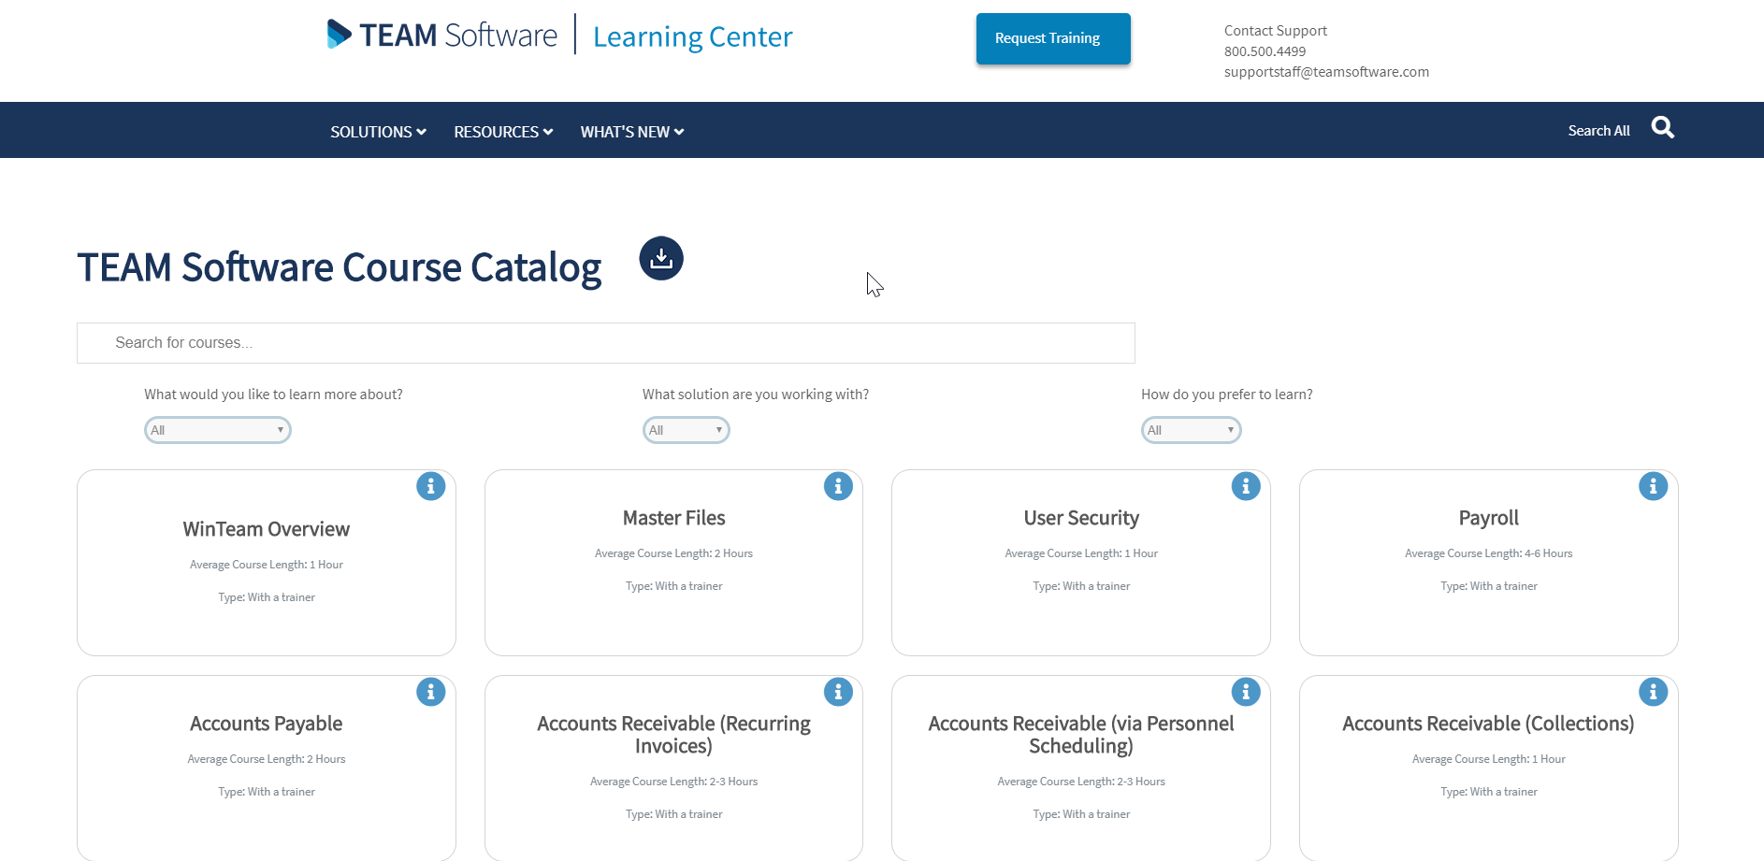
Course Catalog

Slide 16
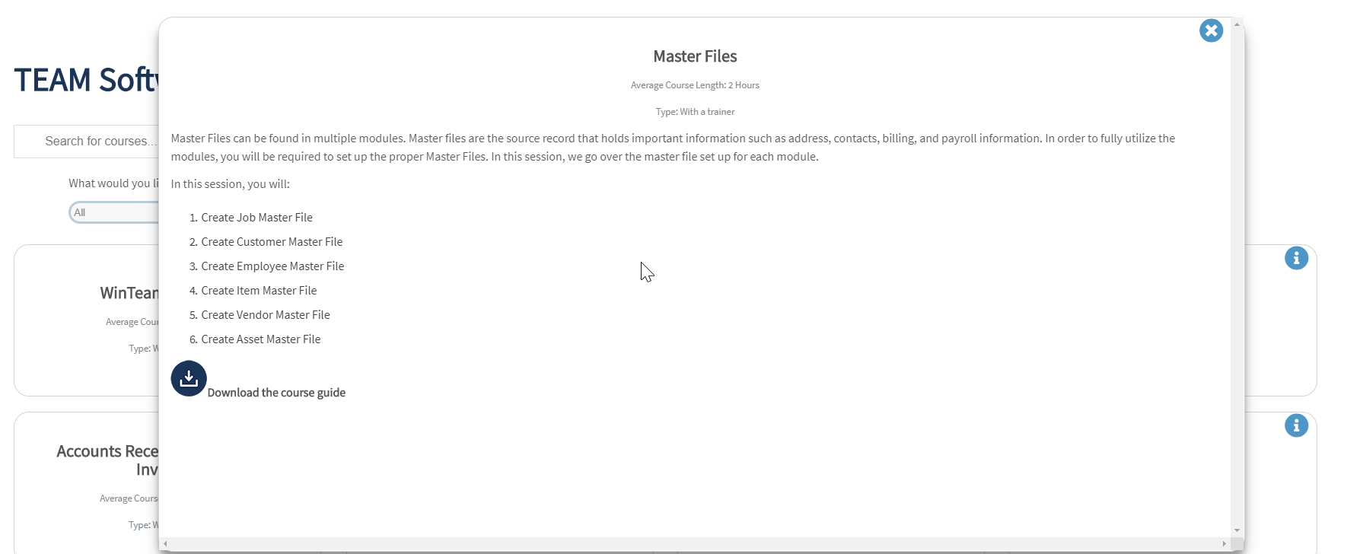
Course Catalog

Slide 17
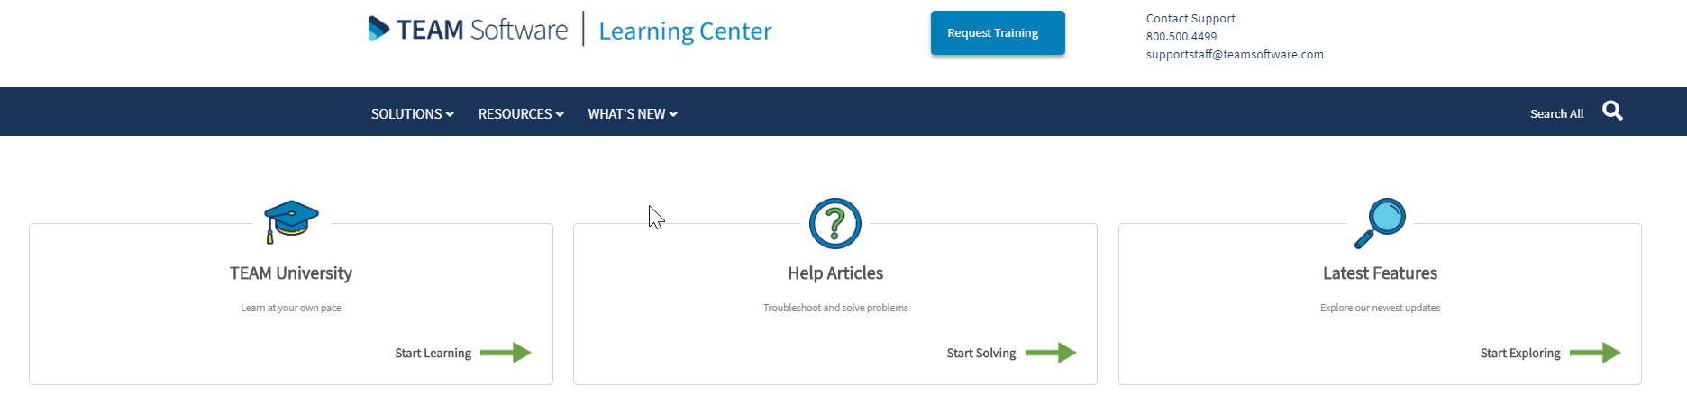
Learning Center V1

Slide 18
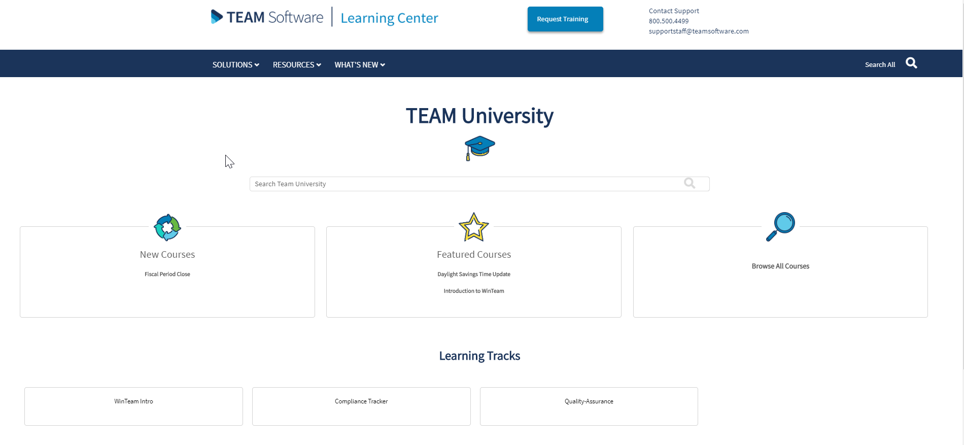
Learning Center V1

Slide 19
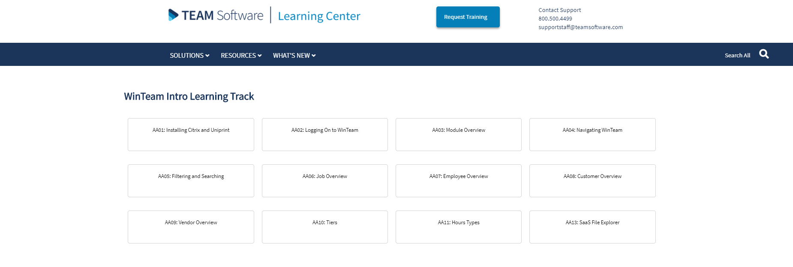
Learning Center V1

Slide 20
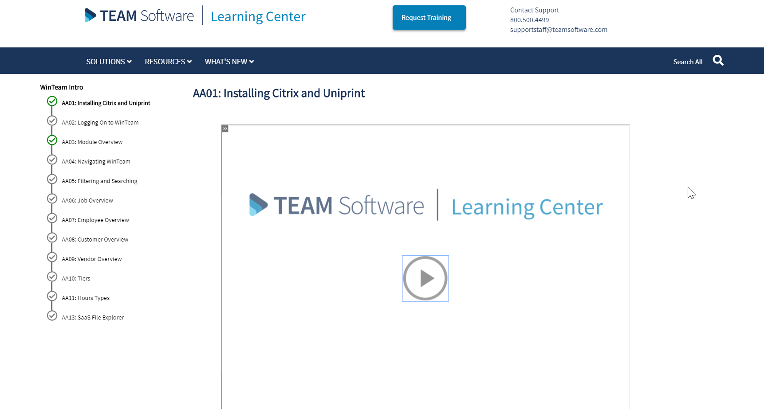
Learning Center V1

Slide 21
Wait… How’d you do that?

Slide 22
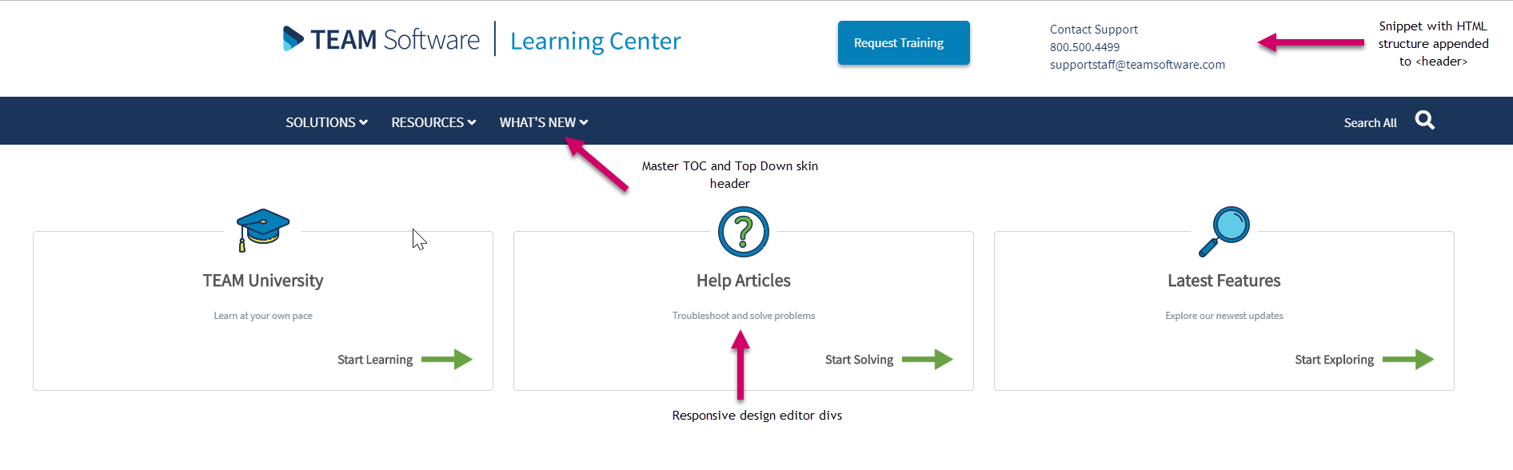
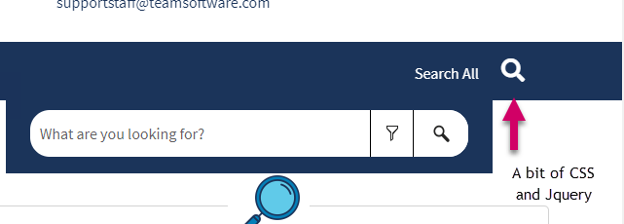
Learning Center Home Page

Slide 23
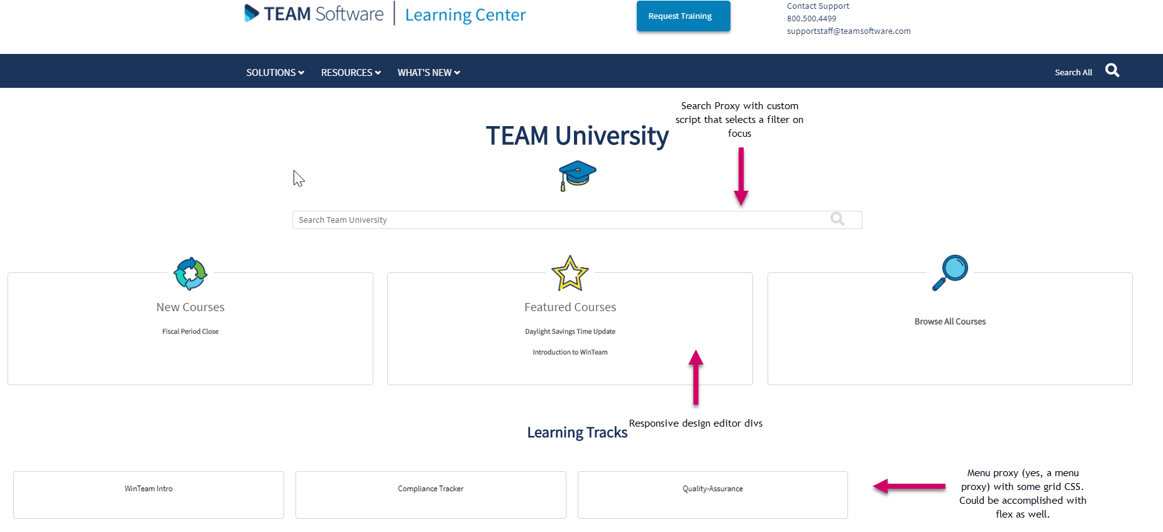
TEAM University Home

Slide 24
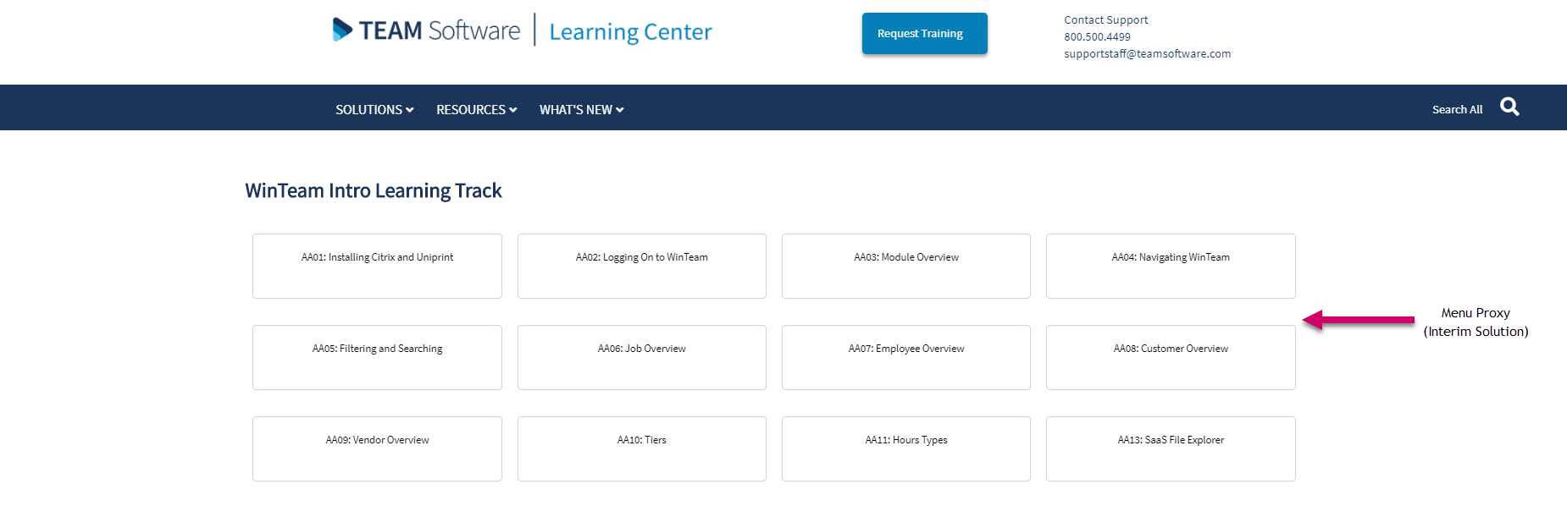
Learning Tracks

Slide 25
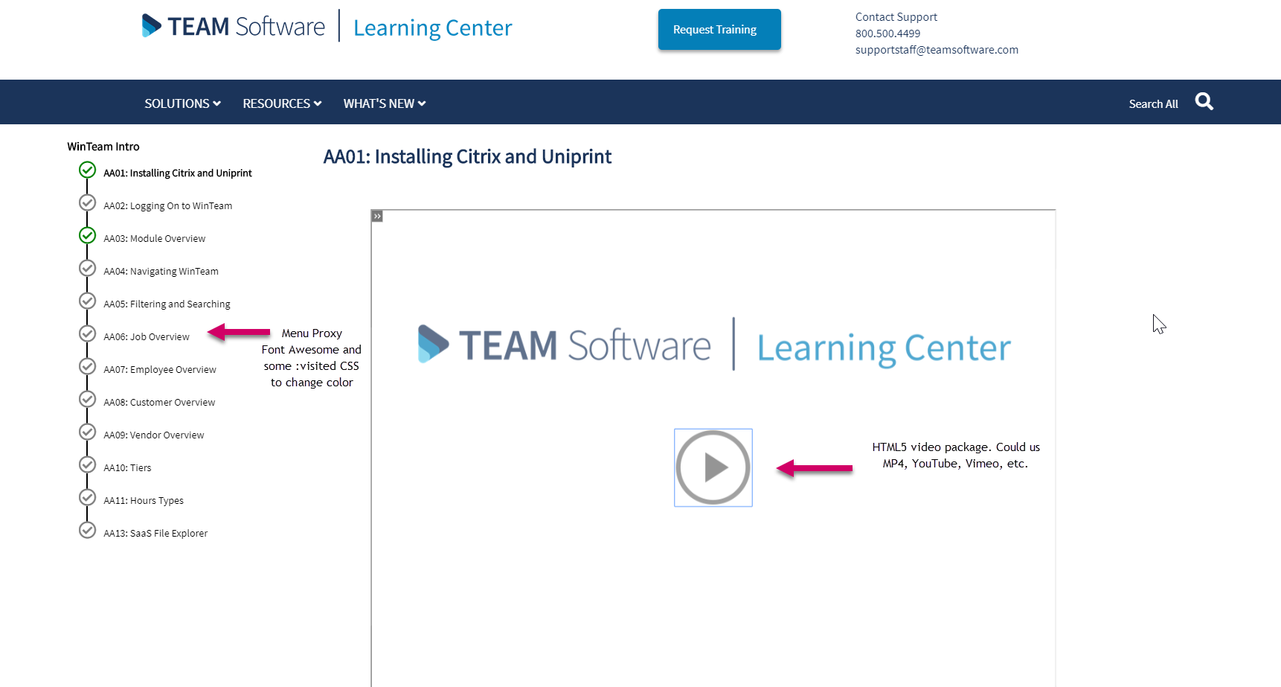
Course

Slide 26
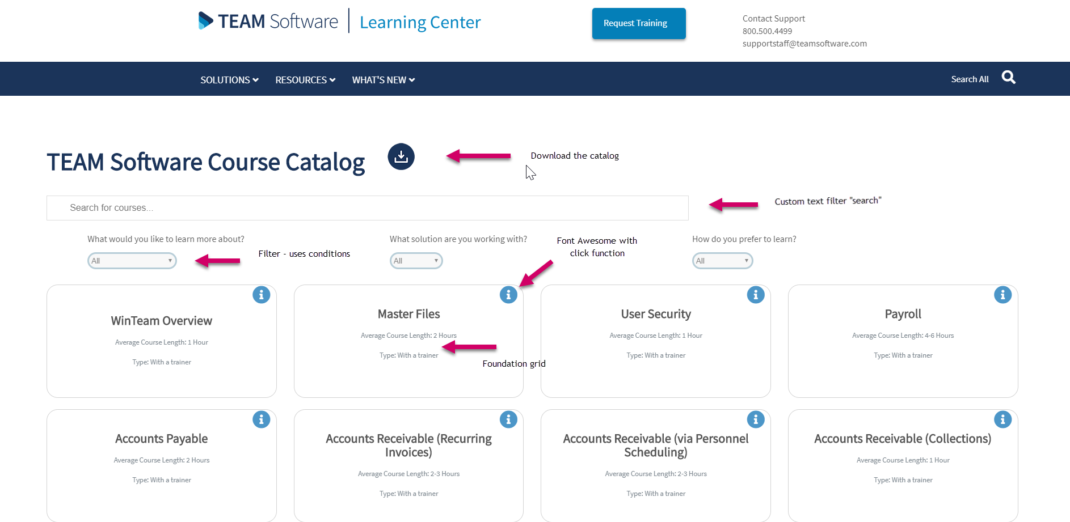
Catalog

Slide 27
Results (so far)

Slide 28
Customer Engagement
We kicked butt
Anecdotally, clients and implementation love this
February 2019 we had >1000% increase in course views over February 2018 (measured using Google Analytics removing TEAM Software IPs)

Slide 29
Time Saved
Working on it
All course information is now downloaded form the Learning Center instead of sent over email (eliminating the middle man)
In progress of single sourcing all training guide information (and creating facilitator guides while we are at it)

Slide 30


Slide 31


Slide 32
Questions?

Slide 33
Contact Chris Jones
Let me know if you have questions or comments:
jonechr2@gmail.com
Flare Slack: Chris Jones
Linkedin: https://www.linkedin.com/in/chris-jones-b27a402b/

